Slide 1
File System Management File System Introduction
Lecture 10 (Live Version)

Slide 2
Overview
File System
Definition
Vs Memory Management
Motivation
File
Metadata
Operations
Directory
Directory Structure

Slide 3
File System: Motivation
Physical memory is volatile
Use external storage to store persistent info
Direct access to the storage media is not portable:
Dependent on hardware specification and organization

Slide 4
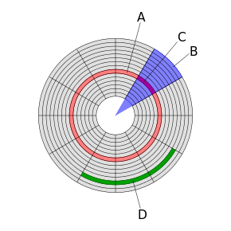
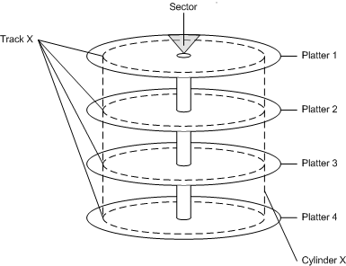
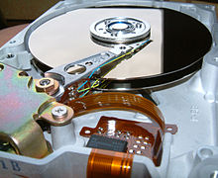
Recap: Hard Disk Layout

Slide 5
File System: General Criteria
Self-Contained:
Information stored on a media is enough to describe the entire organization
Should be able to "plug-and-play"
Persistent:
Beyond the lifetime of OS and processes
Efficient:
Provides good management of free and used space
Minimum overhead for bookkeeping information

Slide 6
Memory Management vs File Management
 | Memory Management | File System Management
Underlying Storage | RAM | Disk
Access Speed | Constant | Variable disk I/O time
Unit of Addressing | Physical memory address | Disk sector
Usage | Address space for process Implicit when process runs | Non-volatile data Explicit access
Organization | Paging/Segmentation: determined by HW & OS | Many different FS: ext* (Linux), FAT* (Windows), HFS* (Mac OS) etc.

Slide 7
Key Topics
File System Abstraction
Delve into a few commonly used file systems
File System Case Studies
Common implementation schemes
File System Implementation Approaches
Discuss the logical entities present in file system
E.g. Files / Directories
Discuss pros/cons

Slide 8
File System abstractions
You mean files and folders are not real?

Slide 9
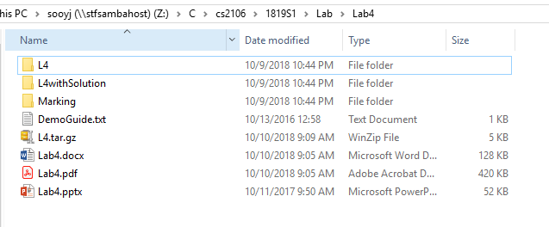
File System Abstraction

Slide 10

File: Overview
Basic Definition
File Metadata
File Data
File structure
Access Methods
File Operations

Slide 11
File: Basic Description
Represent a logical unit of information created by process
An abstraction
Essentially an Abstract Data Type:
A set of common operations with various possible implementation
Contains:
Data: Information structured in some ways
Metadata: Additional information associated with the file
Also known as file attributes

Slide 12
File Metadata
Name: | A human readable reference to the file
Identifier: | A unique id for the file used internally by FS
Type: | Indicate different type of files E.g. executable, text file, object file, directory etc
Size: | Current size of file (in bytes, words or blocks)
Protection: | Access permissions, can be classified as reading, writing and execution rights
Time, date and owner information: | Creation, last modification time, owner id etc
Table of content: | Information for the FS to determine how to access the file

Slide 13
File Name
Different FS has different naming rule
To determine valid file name
Common naming rule:
Length of file name
Case sensitivity
Allowed special symbols
File extension
Usual form Name.Extension
On some FS, extension is used to indicate file type

Slide 14
File Type
An OS commonly supports a number of file types
Each file type has:
An associated set of operations
Possibly a specific program for processing
Common file types:
Regular files: contains user information
Directories: system files for FS structure
Special files: character/block oriented

Slide 15
Two Major Types of Regular Files
ASCII files:
Example: text file, programming source codes, etc
Can be displayed or printed as is
Binary files:
Example: executable, Java class file, pdf file, mp3/4, png/jpeg/bmp etc
Have a predefined internal structure that can be processed by specific program
JVM to execute Java class file
PDF reader for pdf file etc

Slide 16
Distinguishing File Type
Use file extension as indication:
Used by Windows OS
e.g. XXX.docx ➔ Words document
Change of extension implies a change in file type!
Use embedded information in the file:
Used by Unix
Usually stored at the beginning of the file
Commonly known as magic number

Slide 17
File Protection
Controlled access to the information stored in a file
Type of access:
Read: Retrieve information from file
Write: Write/Rewrite the file
Execute: Load file into memory and execute it
Append: Add new information to the end of file
Delete: Remove the file from FS
List: Read metadata of a file

Slide 18
File Protection: How?
Most common approach:
Restrict access base on the user identity
Most general scheme:
Access Control List
A list of user identity and the allowed access types
Pros: Very customizable
Cons: Too much information associated with file
A common condensed file protection scheme is discussed next

Slide 19
File Protection: How? (cont)
Classified the users into three classes:
Owner: The user who created the file
Group: A set of users who need similar access to a file
Universe: All other users in the system
Example (Unix)
Define permission of three access types (Read/Write/Execute) for the 3 classes of users
Use "ls –l" to see the permission bits for a file
rwxr--r-- somefile.eg
Owner
Universe
Group

Slide 20
File Protection: Access Control List
In Unix, Access Control List (ACL) can be:
Minimal ACL (the same as the permission bits)
Extended ACL (added named users / group )
$ getfacl exampleDir # file: exampleDir # owner: sooyj # group: compsc user::rwx user:aaron:rwx group::r-x group:cohort17:rwx mask::rwx other::---

Slide 21
Operations on File Metadata
Rename:
Change filename
Change attributes:
File access permissions
Dates
Ownership
etc
Read attribute:
Get file creation time

Slide 22
File Data: Structure
Array of bytes:
Each byte has an unique offset (distance) from the file start
Fixed length records:
Array of records, can grow/shrink
Can jump to any record easily:
Offset of the N^{th} record = size of Record * (N-1)
Variable length records:
Flexible but harder to locate a record

Slide 23
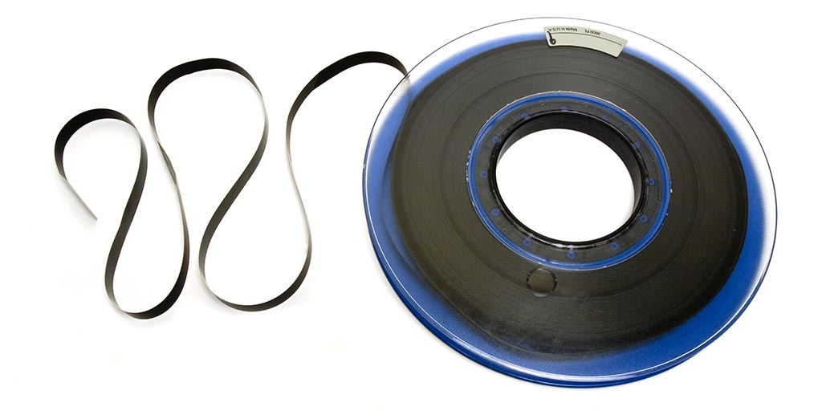
File Data: Access Methods
Sequential Access:
Data read in order, starting from the beginning
Cannot skip but can be rewound
Random Access:
Data can be read in any order
Can be provided in two ways:
Read( Offset ): Every read operation explicitly state the position to be accessed
Seek( Offset ): A special operation is provided to move to a new location in file
E.g. Unix and Windows uses (2)

Slide 24
File Data: Access Methods (cont )
Direct Access:
Used for file contains fixed-length records
Allow random access to any record directly
Very useful where there is a large amount of records
The basic random access method can be view as a special case:
Where each record == one byte

Slide 25
File Data: Generic Operations
Create: | New file is created with no data
Open: | Performed before further operations To prepare the necessary information for file operations later
Read: | Read data from file, usually starting from current position
Write: | Write data to file, usually starting from current position
Repositioning: | Also known as seek Move the current position to a new location No actual Read/Write is performed
Truncate: | Removes data between specified position to end of file

Slide 26
File Operations as System Calls
OS provides file operations as system calls:
Provide protection, concurrent and efficient access
Maintain information
Information kept for an opened file:
File Pointer: Current location in file
Disk Location: Actual file location on disk
Open Count: How many process has this file opened?
Useful to determine when to remove the entry in table
Let's Code!

Slide 27
File Operations as System Calls (cont)
Consider:
Several processes can open the same file
Several different files can be opened at any time
What is a good way to organize the open-file information?
Common approach:
System-wide open-file table:
One entry per unique file
Per-process open-file table:
One entry per file used in the process
Each entry points to the system-wide table

Slide 28
File Operations (Unix)
0
Op.Type: …
File offset: …
"File Data":
File1.abc
Proc A PCB
0
1
…
…
…
…
fd
x
Op.Type: Read
File offset: 1234
"File Data":
File Descriptor
Table
…
…
File2.def
Proc B PCB
0
y
Op.Type: Write
File offset: 5678
"File Data":
1
…
…
…
…
fd
File Descriptor
Table
Open File Table
"Actual File"

Slide 29
Process Sharing File in Unix: Case 1
Two processes using different file descriptors
I/O can occurs at independent offsets
Proc A PCB
Op.Type: …
File offset: 5000
"File Data":
File.abc
fd1
Proc B PCB
Op.Type: …
File offset: 2000
"File Data":
fd2
The shared file

Slide 30
Process Sharing File in Unix: Case 2
Two processes using the same file descriptor
Only one offset ➔ I/O changes the offset for the other process
Parent PCB
Proc A PCB
fd1
File.abc
Op.Type: …
File offset: 3000
"File Data":
Child PCB
Proc B PCB
fd1
The shared file

Slide 31
Directory
i.e. Folder!

Slide 32
Directory: Basics
Directory ( folder ) is used to:
Provide a logical grouping of files
The user view of directory
Keep track of files
The actual system usage of directory
Several ways to structure directory:
Single-Level
Tree-Structure
Directed Acyclic Graph (DAG)
General Graph

Slide 33
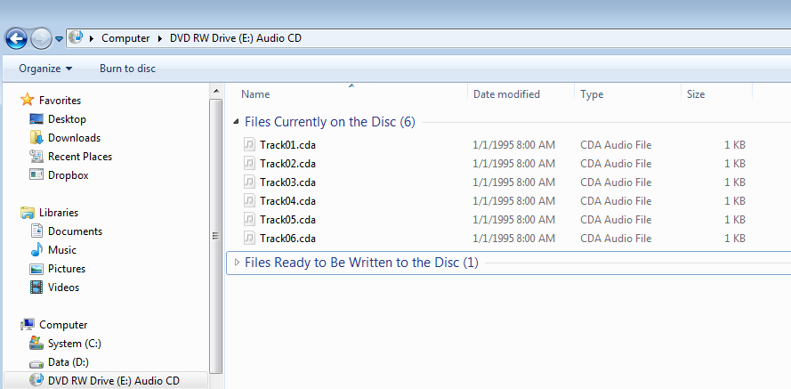
Directory Structure: Single-Level
directory
file 1
file 2
file 3
file 4

Slide 34
Directory Structure: Tree-Structured
dir1
dir2
file 1
file 2
dir3
file 3
file 3

Slide 35
Directory Structure: Tree-Structured
General Idea:
Directories can be recursively embedded in other directories
Naturally forms a tree structure
Two ways to refers to a file:
Absolute Pathname:
Directory names followed from root of tree + final file
i.e. the Path from root directory to the file
Relative Pathname:
Directory names followed from the current working directory (CWD)
CWD can be set explicitly or implicitly changed by moving into a new directory under shell prompt

Slide 36
Directory Structure: DAG
/
dir2
dir3
alias
file3

Slide 37
Directory Structure: DAG
If a file can be shared:
Only one copy of actual content
"Appears" in multiple directories
With different path names
Then tree structure ➔ DAG
Two implementations in Unix:
Hard Link
Limited to file only
Symbolic Link
Can be file or directory
This has an "interesting" effect….

Slide 38
DAG: Unix Hard Link
Consider:
Directory A is the owner of file F
Directory B wants to share F
Hard Link:
A and B has separate pointers point to the actual file F in disk
Pros:
Low overhead, only pointers are added in directory
Cons:
Deletion problems:
e.g. If B deletes F? If A deletes F?
Unix Command: " ln "

Slide 39
DAG: Unix Symbolic Link
Symbolic Link:
B creates a special link file, G
G contains the path name of F
When G is accessed:
Find out where is F, then access F
Pros:
Simple deletion:
If B deletes: G deleted, not F
If A deletes: F is gone, G remains (but not working)
Cons:
Larger overhead:
Special link file take up actual disk space
Unix Command: "ln –s"

Slide 40
Directory Structure: General Graph
/
dir2
cycle
dir3

Slide 41
Directory Structure: General Graph
General Graph Directory Structure is not desirable:
Hard to traverse
Need to prevent infinite looping
Hard to determine when to remove a file/directory
In Unix:
Symbolic link is allowed to link to directory
General Graph can be created

Slide 42
Summary
Covered basics of file system from a user point of view
Understand the basic requirements of a FS
Understand the components of a FS:
File and Directory

Slide 43
Unix File Operations
For your reference only

Slide 44
File Operations Example: Unix System Calls
Header Files:
#include <sys/types.h>
#include <sys/stat.h>
#include <fcntl.h>
File related Unix System Calls
open(), read(), write(), lseek(), close()
General Information:
Opened file has an identifier
File Descriptor: Integer
Used for other operations
File is access on a byte-by-byte basis
No interpretation of data

Slide 45
Opening Files: open( )
Function Call:
int open( char *path, int flags )
Return:
-1: Failed to open file
>=0: file descriptor, a unique index for opened file
Parameters:
path: File path
flags: Many options can be set using bit-wise-OR
Read, Write or Read+Write mode
Truncation, Append mode
Create file if no exists
… Many many more ☺

Slide 46
Opening Files: open() (cont)
Example:
int fd; //file descriptor
//Open an existing file for read only
fd = open( "data.txt", O_RDONLY );
//Create the file if not found, open for read + write
fd = open("data.txt", O_RDWR | O_CREAT );
By convention:
Default file descriptors:
STDIN (0), STDOUT (1), STDERR (2)

Slide 47
Read Operation: read()
Function Call:
int read(int fd, void *buf, int n)
Purpose:
reads up to n bytes from current offset into buffer buf
Return:
number of bytes read, can be 0...n
<n : end of file is reached
Parameters:
fd: file descriptor (must be opened for read)
buf: An array large enough to store n bytes
read() is sequential read:
starts at current offset and increments offset by bytes read

Slide 48
Write Operation: write()
Function Call:
int write(int fd, void *buf, int n)
Purpose:
writes up to n bytes from current offset from buffer buf
Return:
-1: Error
>= 0: Number of bytes written
Parameters:
fd: file descriptor (must be opened for write)
buf: An array of at least n bytes with values to be written
Possible errors:
exceeds file size limit, quota, disk space, etc.
write() is sequential write:
starts at current offset and increments offset by bytes written
can increase file size beyond EOF ➔ append new data

Slide 49
Repositioning: lseek()
Function Call:
off_t lseek(int fd, off_t offset, int whence)
Purpose:
Move current position in file by offset
Return:
-1: Error
>= 0: Current offset in file
Parameters:
fd: file descriptor (must be opened)
offset: positive = move forward, negative = move backward
whence: Point of reference for interpreting the offset
SEEK_SET: absolute offset (count from the file start)
SEEK_CUR: relative offset from current position (+/-)
SEEK_END: relative offset from end of file (+/-)
Can seek anywhere in file, even beyond end of existing data

Slide 50
Closing Files: close()
Function Call:
int close( int fd )
Return:
-1: Error
0: Successful
Parameters:
fd: file descriptor (must be opened)
With close():
fd no longer used anymore
Kernel can remove associated data structures
The identifier fd can be reused later
By default:
Process termination automatically closes all open files

Slide 51
File System: Motivation
Physical memory is volatile
Use external storage to store persistent information
Direct access to the storage media is not portable:
Dependent on hardware specification and organization (see next slide for example)
File System provides:
An abstraction on top of the physical media
A high level resource management scheme
Protection between processes and users
Sharing between processes and users
E

Slide 52
Let's just watch a demo!!!
Slide 13 - 21
E

